Slide 1
Take a deep breath

Slide 2
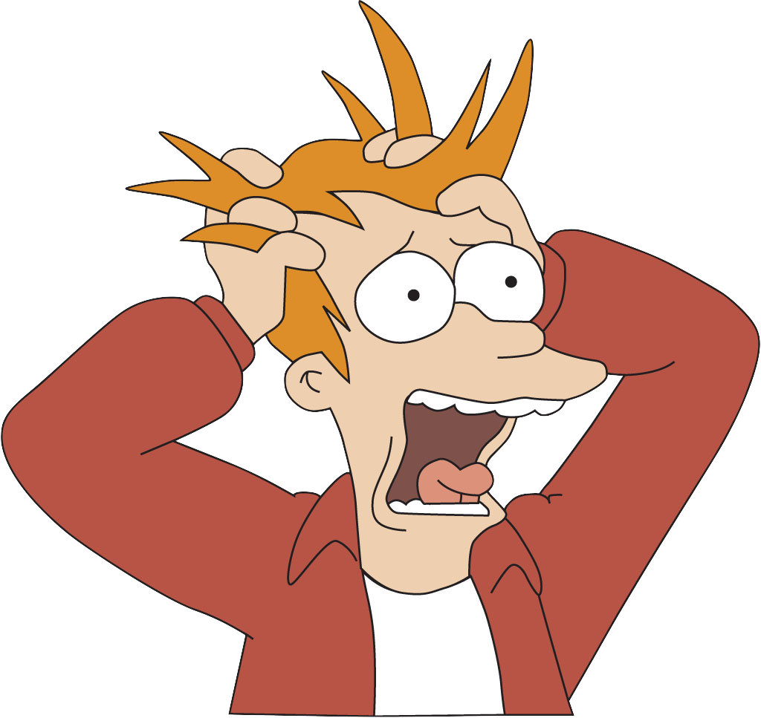
Stress, everyone deals with it.
[Futurama]

Slide 3
Some stress statistics…
48%
$300
billion
48%
76%
People in the US who say stress has a negative impact on their personal and professional life
People in the US who cite money and work as the leading cause of their stress
People in the US who feel their stress has increased over the past 5 years
Annual costs to employers in stress related health care and missed work
Notes:
Stress statistics source:
“Stress Statistics – Statistic Brain.”
2016 Statistic Brain Research Institute, publishing as Statistic Brain.
October 19th, 2015
http://www.statisticbrain.com/stress-statistics/.

Slide 4
How can we avoid it?

Slide 5

reathe
Adam Gray

Slide 6
Breathe is…
A mobile application that learns about you and the things you do
A stress detection, reduction, and avoidance system

Slide 7

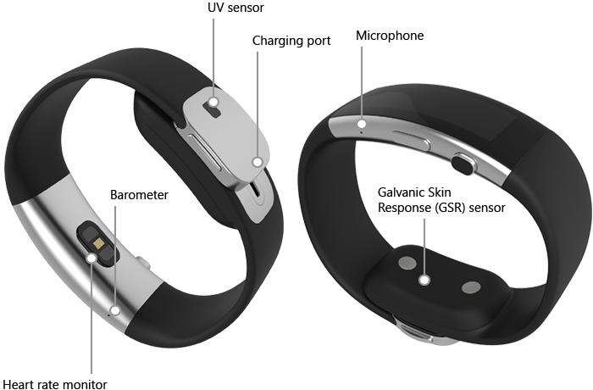
Detecting stress
Microsoft Band
The Microsoft Band is a wrist-worn activity tracker that connects to your smartphone via Bluetooth
Breathe uses the Band’s heart rate monitor to detect and track you stress level in real time

Slide 8
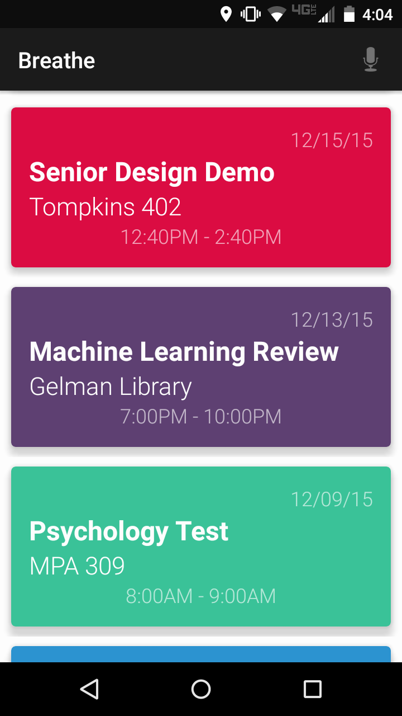
Learning about you
stressed
anxious
neutral
relaxed
Combined with the sensor data collected from the Microsoft Band, Breathe uses details from your calendar events to answer the following:
What are you doing?
How are you doing it? (e.g. actively moving or passively sitting)
Who are you doing it with?
Where are you doing it?
What is the surrounding environment? (e.g. noisy, outdoors, crowded, etc.)

Slide 9
Breathe uses the data to…
Determine which factors and situations of your life either stress you out or help you relax
Predict your next stressful event and show you which combination of factors led to its prediction
Improve over time

Slide 10
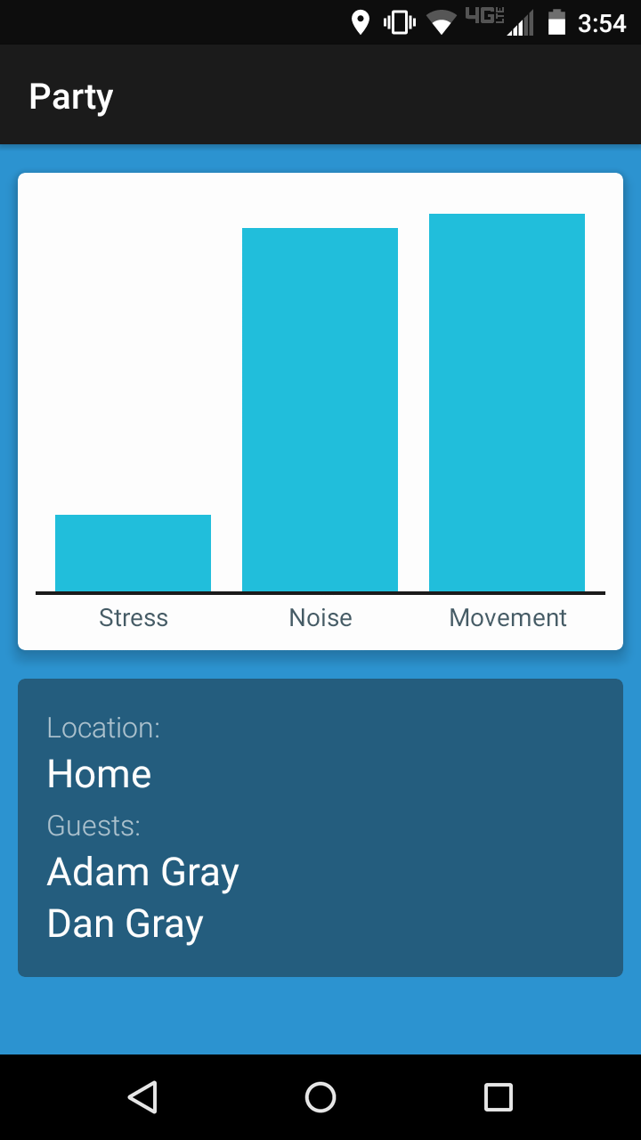
Technical challenges
Detecting a relative noise change from the surrounding environment
Detecting stress level
Predicting future stressful events
Notes:
Need to update UI for screenshot: remove Stress column in bar chart – confusing

Slide 11
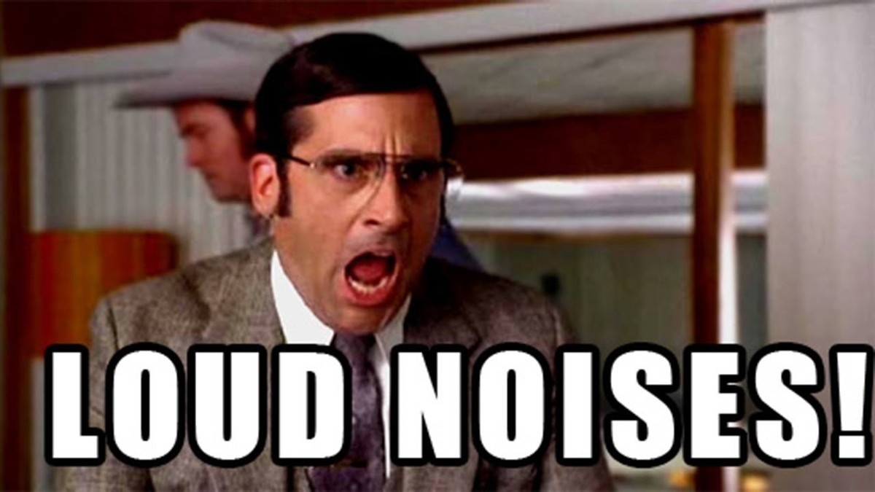
Challenge 1: Noise Level
[Anchorman]

Slide 12
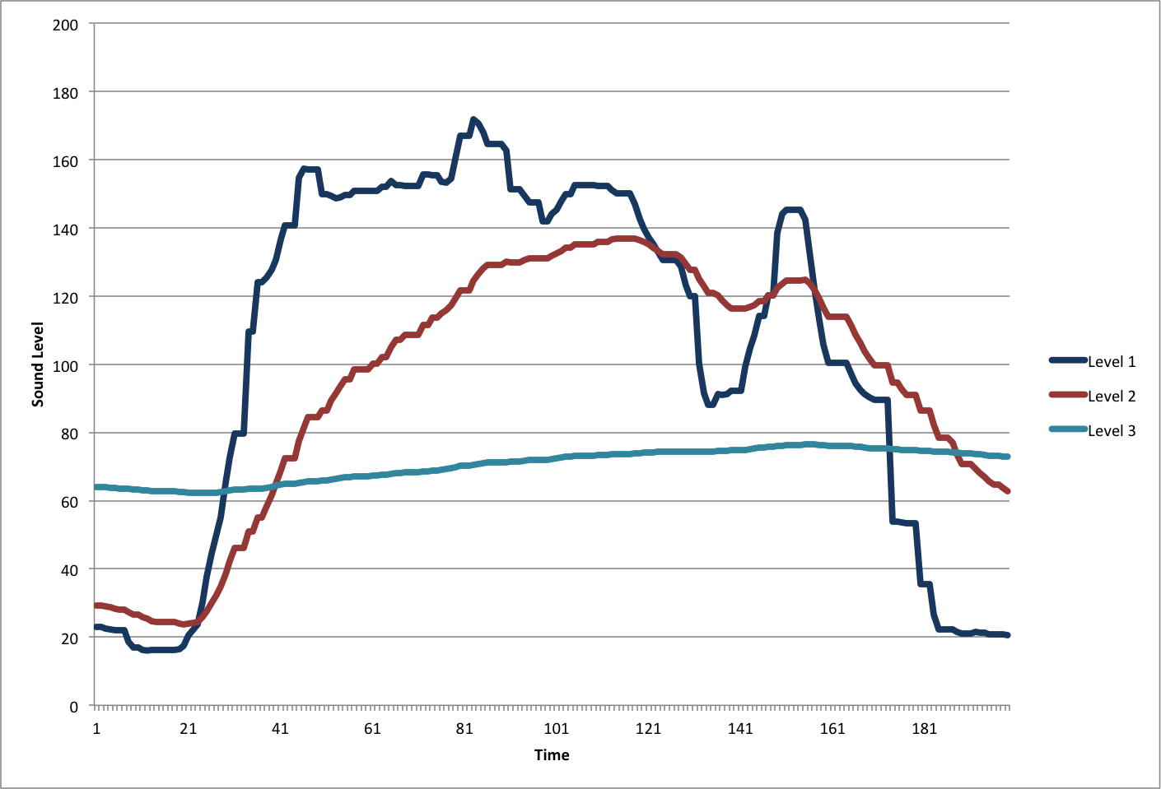
Detecting change in noise level
Noise Level
relative drop in noise
Time

Slide 13
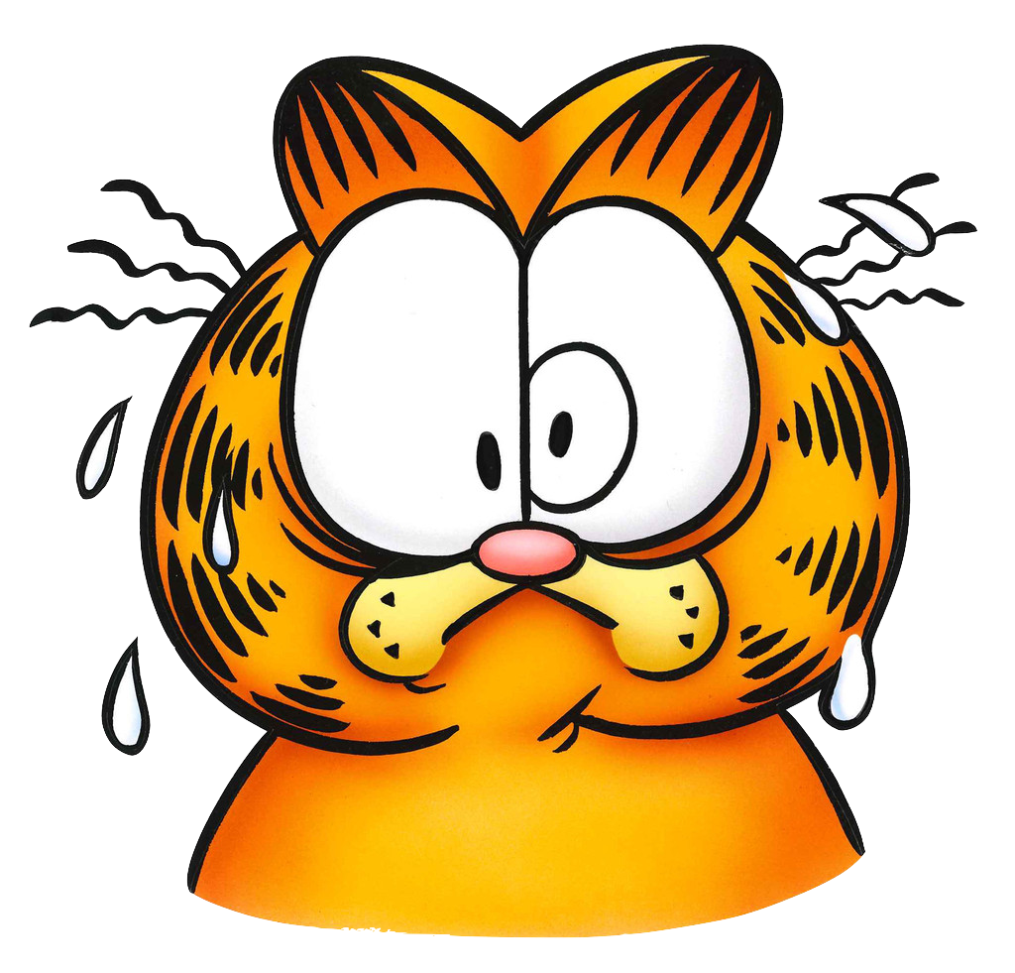
Challenge 2: Stress
Most existing research on non-invasive stress detection has been nearly inconclusive*
An elevated heart rate or increase in perspiration are not reliable indicators
I figured it out.*
[Garfield]

Slide 14
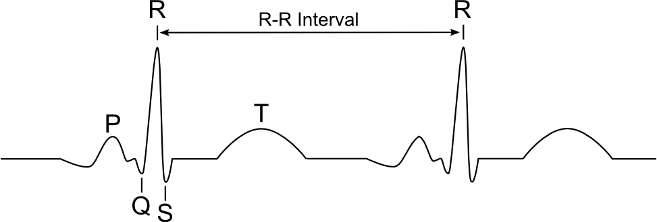
Detecting stress level
While a user is relaxed, there is a detectable pattern in his/her heartbeat that appears when he/she inhales
During times of stress, the pattern is overridden by the autonomic nervous system and can no longer be detected

Slide 15
Demo Time
Notes:
Will remove slide. Current placeholder for demonstration/video

Slide 16
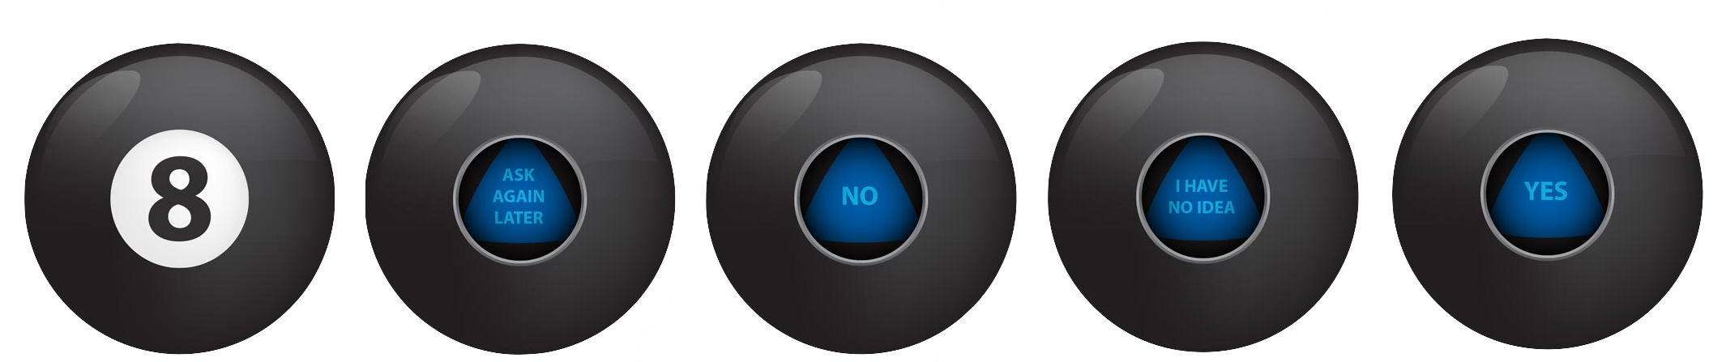
Challenge 3: Prediction
Making an accurate prediction on an unseen event requires knowing what combination of factors lead to stress
There are many unknowable factors that may be the cause of stress, so the algorithm must continue to perform well even with a large amount of randomness in the data

Slide 17
Predicting a stressful event
Breathe tracks the likelihood of all possible factors and combinations of factors leading to a stressful event
Breathe then makes a prediction on whether or not event in your calendar will be stressful
If it’s predicted the upcoming event will be stressful, the user will be notified and the application will display the factors that lead to its prediction
PLACEHOLDER
Notes:
Insert prediction screen shot in place of last bullet point – functionality needs to be added to app first

Slide 18
Breathe…
Is completely unlike any other mobile application
Learns what stresses you out and shares that information with you
Helps you better understand yourself and different aspects of your life
Makes your life easier

Slide 19

Thank you

